Slide 1
Global Water Crisis
By: Reth Abraham

Slide 2
Purpose
I decided to tackle a global problem. Millions of people are without clean water. Some have access to water, but it is not consumer friendly. I am attempting to create a device/program to determine the safety of water and what it contains.

Slide 3
The Global Water Crisis
Pollution of water
Over 785 million people without access to clean water
1 out of every 10 people are without clean water
800 children, under the age of 5, die due to contaminated water
Over 2 billion people living without access to adequate sanitation
Current solutions are electric cars, solar panels, recycling, and chemical compound changes.

Slide 4
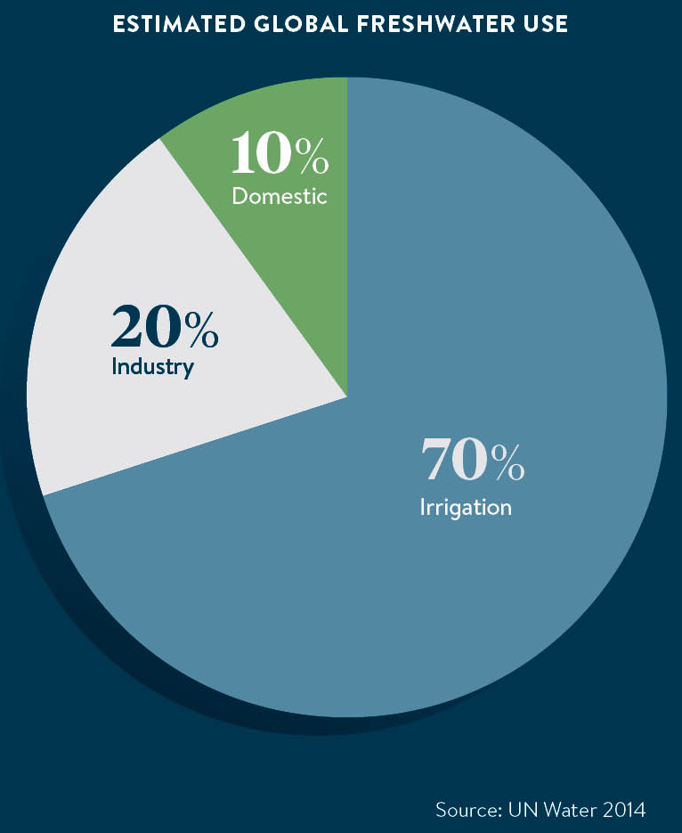
What is the Global Water Crisis
Water covers 70% of the planet
Only 3% of the water is fresh water
2 thirds of that 3% is frozen in glaciers
Many fresh water sources are drying up or polluted.
More than half the wetlands have disappeared.
2/3 of the population may face water shortages by 2025

Slide 5
Water Pollution
Water pollution occurs when harmful substances such as chemicals or microorganisms contaminate a body of water. Degrading the quality and rendering it toxic to the environment.
Toxic substances come from sources such as farms, towns, and factories.
Ground water is polluted by pesticides and fertilizers from landfills and septic systems
Surface water is polluted by farm waste and fertilizer runoff.
Ocean water is polluted by chemicals, metals, plastic, oil, and carbon emissions
Citation: Melissa Denchak, nrdc.org, 2018

Slide 6
Global Effect
People all around the world struggle to access quality water for their needs
Over the past years clean water has become more available
The United Nations recognizes the importance of this issue each year on World Water Day, March 22.
Women and children are the most affected
Access to clean water is a stepping-stone for development
World Vision reaches 1 new person with clean water every 10 seconds and a new person with handwashing behavior change programming as well.

Slide 7
Growing problems in the 21st century
With the shortage in water, parts of the world are left in vulnerable positions.
There is a shortage of renewable supplies
Unequal distribution of supplies
Problems of water quality and health
Disastrous effects of unrestrained construction of dams and reservoirs.
Nicholas L. Cain, Columbia University, 2014

Slide 8
Timeline of Global Water Crisis
1700s – 1800:
urbanization in England
1866:
The united states had 136 public water systems
1972:
The U.S. Clean Water Act
2005:
Global chronic water shortage
1900s:
11 billion people died from drought and 2 billion more affected
1993:
World Water Day
2015:
2.6 billion people gained access to clean water
1800s:
First water shortage historical records
Citation: Kathryn Reid, worldvision.org 2021

Slide 9
Method
When entering data based on water, my program should compare those results to other tested results and determine if the water is consumer friendly or not. Based on the information entered, my program should determine the largest contaminant and possibly provide a solution to removing that contaminant. The program should be run multiple times to test for accuracy and consistent results.

Slide 10
Anticipated Results
Creating a program to determine solvents in the water
Determine if water is consumable based on risk and contaminants in the water
Accurately read the percentage of a solvent in the water

Slide 11
The Response from other Countries
Asia and pacific – 1 of 3 people lack access to drinking water, 500,000 infant deaths
Africa – over 300 million people lack access to clean water, agriculture accounts for 88% of all groundwater consumption
Europe and Central Asia – Lack of access to clean water in East Europe and Central Asia. Declining water quality.
Latin America and the Caribbean – ground water contamination and poor sanitation.
North America – agricultural runoff and depletion.

Slide 12
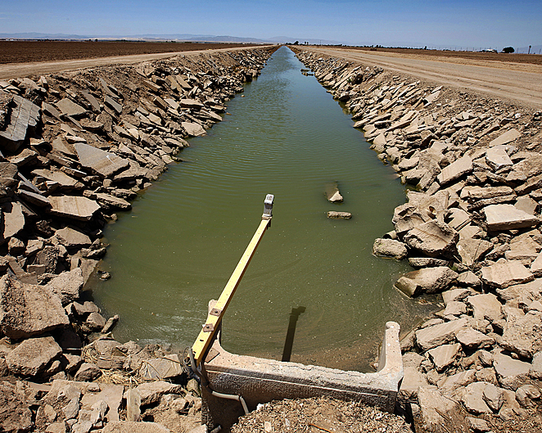
Ways to Solve/Prevent
Educate on the consumption and lifestyle
Invent new water conservation technology
Recycle wastewater
Improve water catchment and harvesting
Develop and enact better policies and regulations
Eliminate pollution
Population growth control
Citation: J.Carl Ganter/Circleofblue.org 2010

Slide 13
Current Implementations
Knowyourh20.com provides readers with history, and relevant information on the global water crisis. They also provide readers with a self-diagnostic questionnaire, recommended testing kit, expert advice, and treatment solution.

Slide 14
Conclusion
Water is precious and should be taken care of
Many people are impacted why the Global water crisis
The crisis is a problem that needs to be addressed
There are ways to solve it and increase the amount of clean water available

Slide 15
References
https://www.worldvision.org/clean-water-news-stories/global-water-crisis-facts
https://www.worldwildlife.org/threats/water-scarcity
https://www.nrdc.org/stories/water-pollution-everything-you-need-know
https://www.circleofblue.org/2010/world/experts-name-the-top-19-solutions-to-the-global-freshwater-crisis/
https://heinonline.org/HOL/LandingPage?handle=hein.journals/gjicl42&div=17&id=&page=
https://www.jstor.org/stable/26476158?seq=6#metadata_info_tab_contents
https://www.sciencedirect.com/science/article/abs/pii/S030691921000059X
https://pubmed.ncbi.nlm.nih.gov/12291371/
https://pubmed.ncbi.nlm.nih.gov/12448404/
https://www.knowyourh2o.com/indoor-3/drinking-water-self-diagnostic-tool

